Slide 1
What is a tree?

Slide 2
Root →
50
Root is never a child.
It’s a parent / internal node or a leaf.
Every non-leaf node is a parent.
Parent →
( Internal
Node )
← Child
35
70
Non-root nodes are children.
22
41
81
Child/Leaf
Child/Leaf
Child/Leaf

Slide 3
Binary Tree
A binary tree is a collection of nodes.
Each node has a data value and
references to two other nodes.
Each node could have a left child
and/or a right child.
1
2
3
4
5
6
7

Slide 4
Java Classes that
Use Binary Trees

Slide 5
TreeSet and TreeMap
TreeSet and TreeMap were built
using binary trees.
1
2
3
4
5
6
7

Slide 6
TreeMap
Map<Integer,String> map;
map = new TreeMap<Integer,String>();
map.put(1,"one");
map.put(2,"two");
map.put(3,"three");
map.put(4,"four");
map.put(5,"five");
map.put(6,"six");
map.put(7,"seven");
System.out.println(map.get(1));
System.out.println(map.get(13));
System.out.println(map.get(7));
OUTPUT one null seven

Slide 7
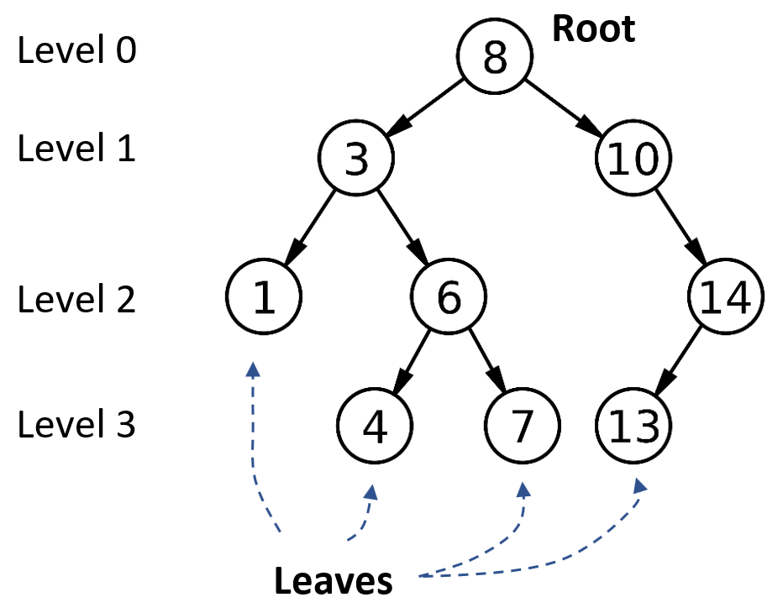
LEVEL = ROW = nodes with same height
NumLevels =
NumLevels = 4

Slide 8
Num leaves:
Num parents:
Num children:
Num nodes:
4
5
8
9

Slide 9
Types of
Binary Trees

Slide 10
Senses of “Full”
A node is full if it has two children.
A level is full if it contains its full capacity of nodes.
The first two rows of this tree are full.
The only node considered full is the root.
Notes:
Theorems: Let T be a nonempty, full binary tree. Then:
(a) If T has I internal nodes (i.e. parent nodes), the number of leaves is L = I + 1.
(b) If T has I internal nodes, the total number of nodes is N = 2I + 1.
(c) If T has a total of N nodes, the number of internal nodes is I = (N – 1)/2.
(d) If T has a total of N nodes, the number of leaves is L = (N + 1)/2.
(e) If T has L leaves, the total number of nodes is N = 2L – 1.
(f) If T has L leaves, the number of internal nodes is I = L – 1.

Slide 11
A Complete Tree
In a complete tree, every level above the bottom level is filled. The bottom level has all nodes shifted as far left as possible.

Slide 12
A Perfect
BINARY TREE
A perfect binary tree is a complete binary tree with the last level also filled completely.

Slide 13
A Full
BINARY TREE
A full / proper binary tree is strictly binary, i.e. every node has exactly two children or no children at all.
Equivalently: every parent is full.
Notes:
Theorems: Let T be a nonempty, full binary tree. Then:
(a) If T has I internal nodes (i.e. parent nodes), the number of leaves is L = I + 1.
(b) If T has I internal nodes, the total number of nodes is N = 2I + 1.
(c) If T has a total of N nodes, the number of internal nodes is I = (N – 1)/2.
(d) If T has a total of N nodes, the number of leaves is L = (N + 1)/2.
(e) If T has L leaves, the total number of nodes is N = 2L – 1.
(f) If T has L leaves, the number of internal nodes is I = L – 1.

Slide 14
A Full
BINARY TREE
Full binary tree theorem: The number of leaves is always one more than the number of parents (a.k.a. internal nodes).
Leaves = Parents + 1
Parents = 2
Leaves = 3
Total nodes = 5
Notes:
Theorems: Let T be a nonempty, full binary tree. Then:
(a) If T has I internal nodes (i.e. parent nodes), the number of leaves is L = I + 1.
(b) If T has I internal nodes, the total number of nodes is N = 2I + 1.
(c) If T has a total of N nodes, the number of internal nodes is I = (N – 1)/2.
(d) If T has a total of N nodes, the number of leaves is L = (N + 1)/2.
(e) If T has L leaves, the total number of nodes is N = 2L – 1.
(f) If T has L leaves, the number of internal nodes is I = L – 1.

Slide 15
A Full
BINARY TREE
Full binary tree theorem 2: The number of nodes is always one more than twice the number of parents (a.k.a. internal nodes).
N = 2 * P + 1
P = (N – 1) / 2
Parents = 2
Leaves = 3
Total nodes = 5
L = ????????
Notes:
Theorems: Let T be a nonempty, full binary tree. Then:
(a) If T has I internal nodes (i.e. parent nodes), the number of leaves is L = I + 1.
(b) If T has I internal nodes, the total number of nodes is N = 2I + 1.
(c) If T has a total of N nodes, the number of internal nodes is I = (N – 1)/2.
(d) If T has a total of N nodes, the number of leaves is L = (N + 1)/2.
(e) If T has L leaves, the total number of nodes is N = 2L – 1.
(f) If T has L leaves, the number of internal nodes is I = L – 1.

Slide 16
A Full
BINARY TREE
P = (N – 1)/2
L – 1 = (N – 1)/2
L = (N – 1)/2 + 1
L = (N – 1)/2 + 2/2
L = (N – 1 + 2)/2
L = (N + 1) / 2
Parents = 2
Leaves = 3
Total nodes = 5
Notes:
Theorems: Let T be a nonempty, full binary tree. Then:
(a) If T has I internal nodes (i.e. parent nodes), the number of leaves is L = I + 1.
(b) If T has I internal nodes, the total number of nodes is N = 2I + 1.
(c) If T has a total of N nodes, the number of internal nodes is I = (N – 1)/2.
(d) If T has a total of N nodes, the number of leaves is L = (N + 1)/2.
(e) If T has L leaves, the total number of nodes is N = 2L – 1.
(f) If T has L leaves, the number of internal nodes is I = L – 1.

Slide 17
A Full
BINARY TREE
N = 2P + 1
P = (N – 1) / 2
L = (N + 1) / 2
N = 2L – 1
Parents = 2
Leaves = 3
Total nodes = 5
Notes:
Theorems: Let T be a nonempty, full binary tree. Then:
(a) If T has I internal nodes (i.e. parent nodes), the number of leaves is L = I + 1.
(b) If T has I internal nodes, the total number of nodes is N = 2I + 1.
(c) If T has a total of N nodes, the number of internal nodes is I = (N – 1)/2.
(d) If T has a total of N nodes, the number of leaves is L = (N + 1)/2.
(e) If T has L leaves, the total number of nodes is N = 2L – 1.
(f) If T has L leaves, the number of internal nodes is I = L – 1.

Slide 18
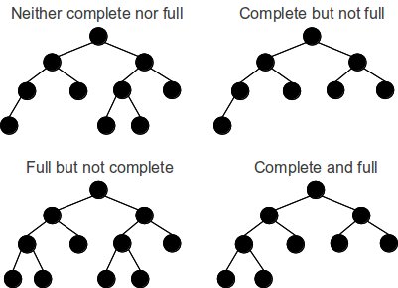
Neither complete nor full
Complete but not full
Full but not complete
Both complete and full

Slide 19
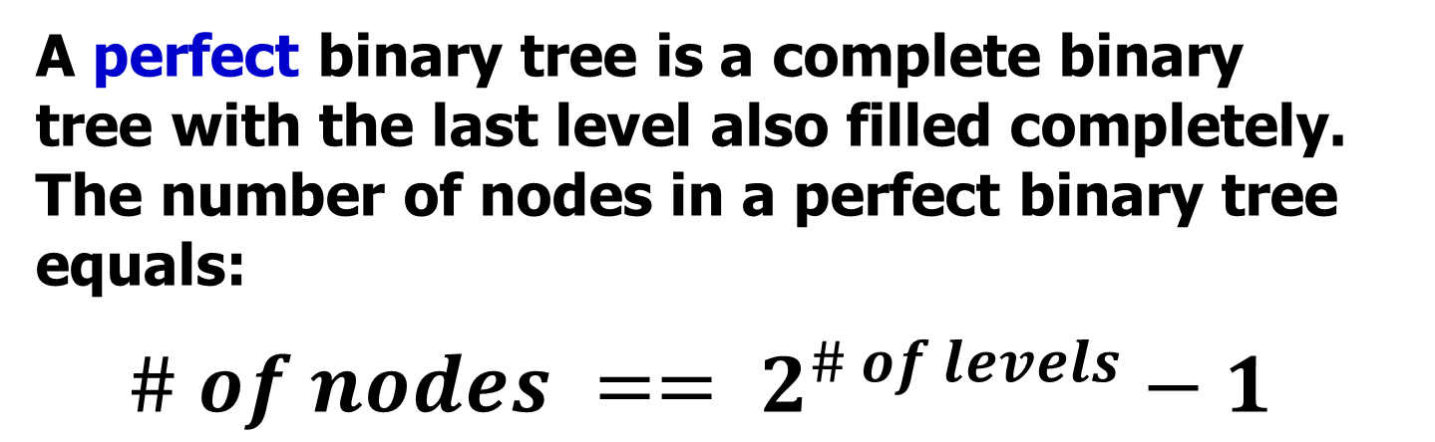
A Perfect
BINARY TREE
A perfect binary tree is a complete binary tree with the last level also filled completely. The number of nodes in a perfect binary tree equals:
$$\# of nodes == 2^{\# of levels}−1$$
There are 7 nodes:
2^{(3 levels)} – 1 = 7

Slide 20
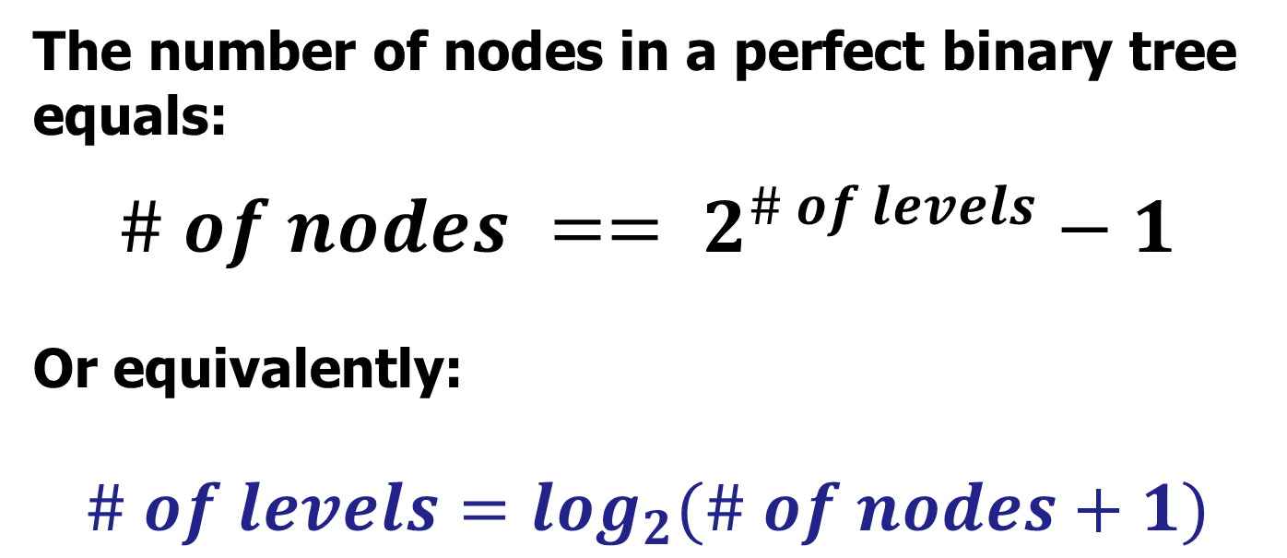
A Perfect
BINARY TREE
The number of nodes in a perfect binary tree equals:
$$\# of nodes == 2^{\# of levels}−1$$
Or equivalently:
$$\# of levels=\log_{2}(\# of nodes+1)$$
Notes:
Note that some will write the formula using the HEIGHT instead of the # of LEVELS.

Slide 21
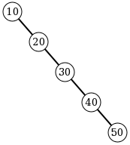
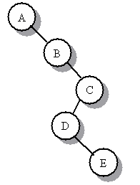
A degenerate binary tree
A tree where each parent node has only one associated child node. This means that performance-wise, the tree will behave like a linked list.

Slide 22
Binary
Search
Trees

Slide 23
Binary Search Tree
A Binary Search Tree is binary tree with no duplicate values in which:
the data in every left node is less than the data in its parent
the data in the right node is greater than the data in its parent.

Slide 24
Binary
Search
Tree
Root
left child is
less than the
parent and
right child
is greater
50
35
70
22
41
81

Slide 25
Binary Search Tree (BST)
In other words, for every node:
All nodes in the left subtree have values that are less than the value in that node, and
All values in the right subtree are greater.
5
< 5
2
8
> 5
0
3
7
9

Slide 26
Which of the trees shown are legal binary search trees?
✓
-5
42
?
?
m
-1
-7
8
?
g
?
q
5
11
b
k
x
✓
2
7
10
18
7.2
e
4
20
?
1.9
9.6
18
8.1
21.3

Slide 27
Printing a
Search Tree

Slide 28
Level Order
90
50
120
40
65
100
150
30
45
70
Level order (i.e. one level at a time):
90 50 120 40 65 100 150 30 45 70
System.out.println(tree);

Slide 29
Tree Traversals
90
50
120
40
65
100
150
30
45
70
IN-ORDER Traversal:
Left branch, Node, Right branch
30 40 45 50 65 70 90 100 120 150

Slide 30
Tree Traversals
90
50
120
40
65
100
150
30
45
70
PRE-ORDER Traversal:
Node, Left branch, Right branch
90 50 40 30 45 65 70 120 100 150

Slide 31
Tree Traversals
90
50
120
40
65
100
150
30
45
70
POST-ORDER Traversal:
Left branch, Right branch, Node
30 45 40 70 65 50 100 150 120 90

Slide 32
Tree Traversals
90
50
120
40
65
100
150
30
45
70
REV-ORDER Traversal:
Right branch, Node, Left branch
150 120 100 90 70 65 50 45 40 30

Slide 33
Why?
Pre-order traversal while duplicating nodes and values can make a complete duplicate of a binary tree.
In-order traversal is very commonly used on binary search trees because it returns values from the underlying set in order, according to the comparator that set up the binary search tree (hence the name).
Post-order traversal while deleting or freeing nodes and values can delete or free an entire binary tree. If you don't use post-order traversal during deletion, then you lose the references you need for deleting the child trees

Slide 34
Why?
To translate between the tree and some serial representation. Suppose you have this parse tree:
*
/ \
+ \
/ \ \
A B C
You could serialize it as:
* + A B C by walking it in prefix order, or as
A B + C * by walking it in postfix order or as
(A + B) * C by walking in order.

Slide 35
In Order 1
public void inOrder() {
inOrder(root);
}
private void inOrder(TreeNode tree) {
if (tree != null){
inOrder(tree.getLeft());
out.print(tree.getValue() + " ");
inOrder(tree.getRight());
}
}
LEFT
DATA
RIGHT

Slide 36
In Order 2
public void inOrder() {
inOrder(root);
}
private void inOrder(TreeNode tree) {
if (tree == null){ return;
}
inOrder(tree.getLeft());
out.print(tree.getValue() + " ");
inOrder(tree.getRight());
}
LEFT
DATA
RIGHT

Slide 37
toString
public String toString()
{
return toString(root);
}
private String toString(TreeNode tree)
{
if (tree != null)
return toString(tree.getLeft()) + " "
+ tree.getValue() + " " +
toString(tree.getRight());
return "";
}
Data is in the MIDDLE!!!

Slide 38
Binary Tree Traversals
In-Order
LEFT
DATA
RIGHT
DATA
LEFT
RIGHT
Pre-Order
LEFT
RIGHT
DATA
Post-Order
RIGHT
DATA
LEFT
Reverse-Order

